Slide 1
Module 6 program and portfolio management
Mgmt 6054 project strategic management

Slide 2
Module agenda
Program and portfolio management
Project management office (PMO)
Introduction to project selection (in preparation for Modules 7 and 8)
Homework/evaluations

Slide 3
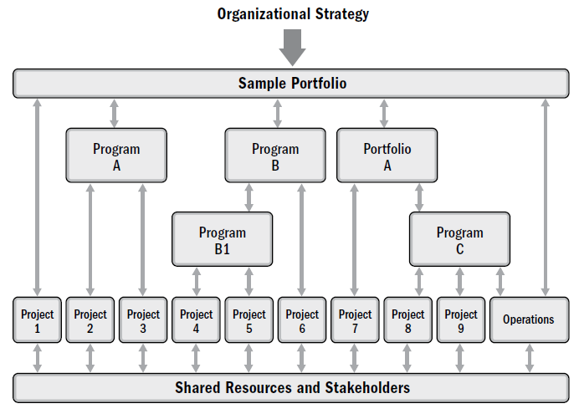
Projects, programs and portfolios
Program:
A group of projects managed in a coordinated way to obtain benefits and control not available from managing them individually.
Portfolio:
Portfolio is a collection of programs and projects grouped together to manage them efficiently
Portfolio management is about making the right investments for the organization to maximize return on investment
Note that one project is directly under a portfolio (but most projects are usually under programs)
Notes:
Image – see references slide

Slide 4
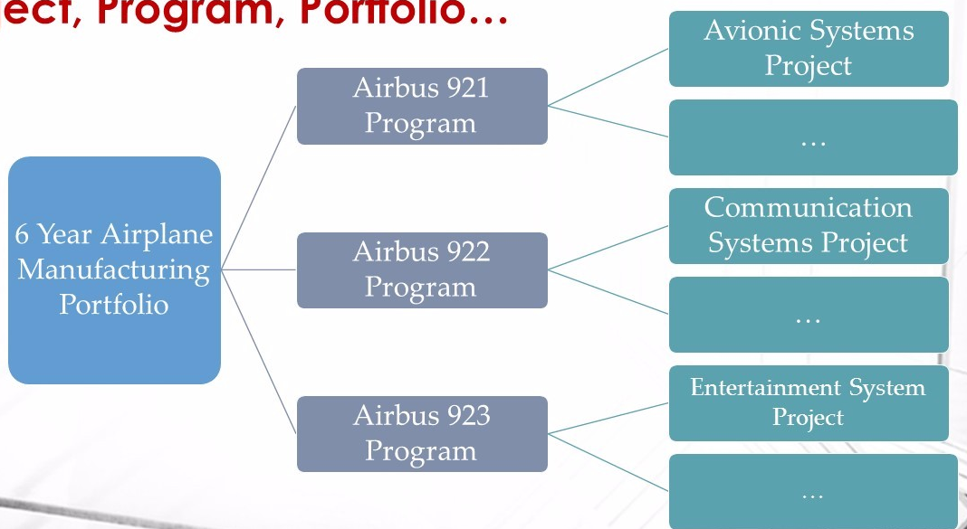

example
Notes:
Image masterofproject.com

Slide 5
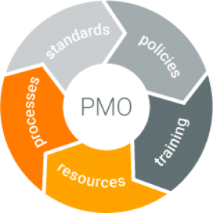

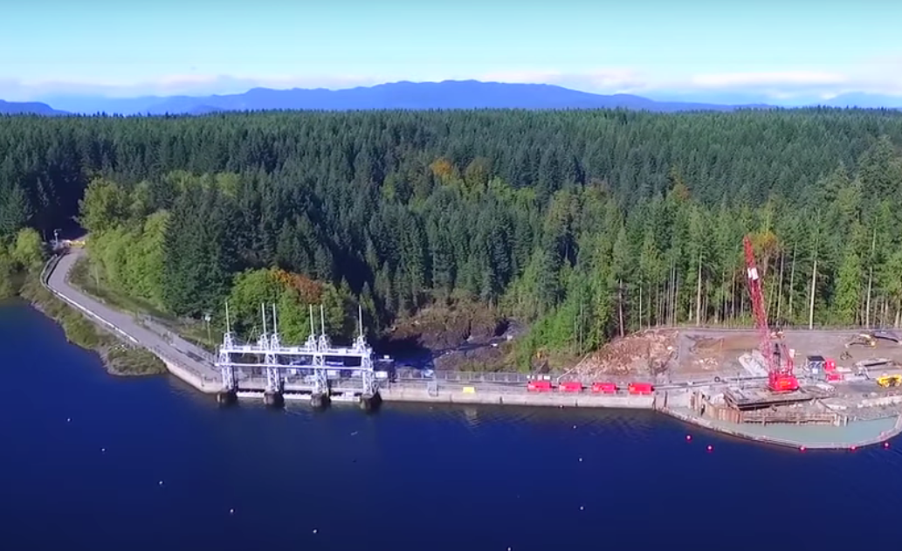
Project management office (pmo)
Centralized management of projects
Standardization: methodology, templates, processes
Training, mentoring
Resource management
Reporting
BC Hydro – PMO of the Year. Click here.
Notes:
Image https://project-management.com/goals-of-an-enterprise-project-management-office-pmo/

Slide 6
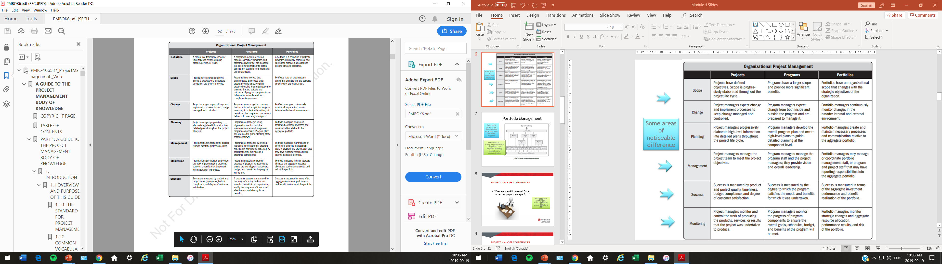
Organizational project management (OPM)
Ultimate goal of any PMO and OPM is success completion of projects and delivery of benefits

Slide 7

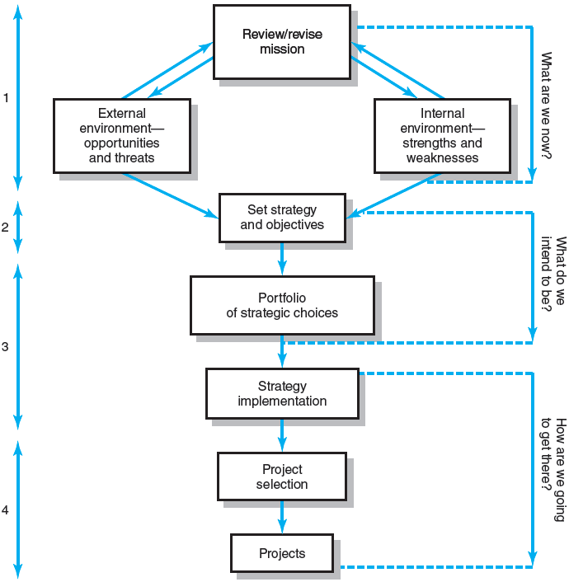

Strategy implementation
The path from corporate mission statement to selection of projects.
In other words, corporate strategy and change is implemented primarily through projects.
A government’s vision driving their projects. Click here.
Notes:
Image: Project Management, The Managerial Process 7E, Larson and Gray

Slide 8

Project selection
Why go through process of project selection?
Organizations end up doing too many projects….that are “all” considered “high” priority
Taking on too many projects often results in project running late, over budget, and not delivering the promised goods or services
Resources, funding, people’s energy, and executive attention are finite.
About saying “no” to projects

Slide 9

Understanding the reasoning behind projects selected
Before we get into the project selection process…..
As a project manager, you may or may not be involved with the feasibility or benefit-to-cost analysis (sometimes called a cost benefit analysis).
Note: Cost-Benefit Analysis, CBA is the same thing as a Benefit/Cost Analysis BCA. The terms are used interchangeably in industry, but both typically use a Benefit Cost Ratio BCR where the benefits are the numerator and the costs are the denominator -- make sure you don’t reverse them.
You still need to know and understand the process, and how/why the project was selected to proceed.
WHY?
Article: Click here.

Slide 10
Understanding the reasoning behind projects selected
From article on previous slide:
During the project’s initiation, the project manager should take the time to understand the business case supporting the sponsor’s rationale for investing in the project.
A project manager who has only a cursory understanding of the impacted business processes may be less likely to understand if some fundamental assumptions are invalid, or might miss threats which would impact successful benefits realization.
If the assumptions underlying those estimates do not appear to be valid or if the project manager believes that a key constraint might have been missed, the PM should not hold back on sharing concerns.

Slide 11

Let’s consider potential projects from the perspective of a home owner
Lots of potential projects to increase value of your home:
complete kitchen renovation
finish basement
add a bathroom
customize master bedroom closet
improve landscaping
paint throughout
etc.
How would you determine which project(s) to take on?
It depends on your strategy/goals
Notes:
Image http://www.couteaux-hommedesbois.com/home/five-motives-why-people-prefer-to-upgrades-house/

Slide 12
Project selection process
Project (or projects) being considered
Feasibility study
Benefit-to-cost analysis
CAN the project be done? Consider cost, technological, legal, safety, marketability and ease of execution requirements, etc. Is the project viable, practical, and achievable?
SHOULD the project be done? Consider net present value, cash flows, rate of return, probability of success, reality of assumptions and constraints

Slide 13
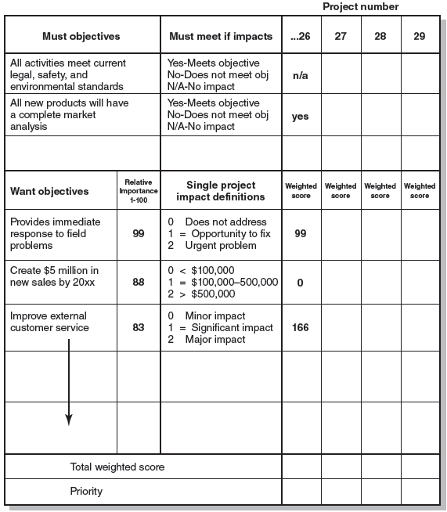
Project selection – comparing options
Feasibility study
Project that do not satisfy “must” objectives do not move on to “want” objective evaluation
Notes:
Image: Project Management, The Managerial Process 7E, Larson and Gray

Slide 14
Feasibility study
A second example of a weighted decision matrix without “must” objectives:
Three projects being considered.
Criteria | Weight | SJS Enterprises | Game Access | DVD Link
Technically possible | 15% | 90 | 0 | 0
Manageable risks | 15% | 90 | 90 | 90
Ease of execution | 10% | 90 | 50 | 50
 | (rows left out here, there are more criteria rows missing)
Weighted Project Scores | 100% | 56 | 14.5 | 12.5

Slide 15
Feasibility study - Exercise
What are the weighted project scores for these 3 CRM software offerings? Note there are extra columns for you to fill-in your calculations. Note, in this matrix, a low cost for the software is a high score. The scores were from 1 to 20.
Criteria | Weight | CRM Bravo |  | RevForce |  | CloudCRMX
Cost | 20% | 11 |  | 9 |  | 16
East of use | 30% | 12 |  | 14 |  | 13
Customization | 50% | 16 |  | 17 |  | 13
Weighted Project Scores | 100% | 13.8 |  | 14.5 |  | 13.6
Solve for these 3 options, then move this graphic aside to reveal the answers!
Notes:
Criteria Weight CRM Bravo RevForce CloudCRMX
Cost 20% 11 2.2 9 1.8 16 3.2
East of use 30% 12 3.6 14 4.2 13 3.9
Customization 50% 16 8 17 8.5 13 6.5

Slide 16
Project selection process
Project (or projects) being considered
Feasibility study
Benefit-to-cost analysis
In upcoming modules, we will explore net present value, cash flow analysis, payback period, internal rate of return, and other financial aspects of benefit-to-cost analysis. But, first, let’s review some financial analysis fundamentals.

Slide 17
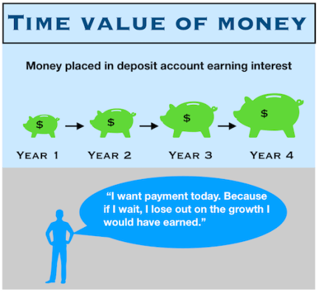
Time value of money
https://www.youtube.com/watch?v=MdK-A1VQJls
Notes:
Image marketbusinessnews.com

Slide 18
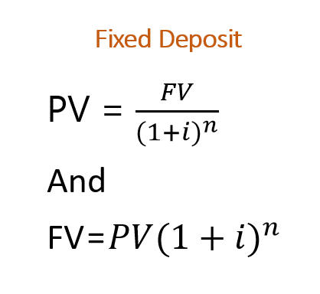


present value and future value
r
r
Present Value and Future Value.
Click here.
Where:
PV = Present Value
FV = Future Value
r (or k or i)= interest/discount rate (decimal format)
n = number of compounding periods

Slide 19
Present value and future value examples
r
Sara invested $1,350 at 4.2% compounded annually for 3 years and 5 months, then reinvested the funds at 5% compounded annually for 5 more years and 7 months. Calculate the amount of interest earned at the end of 9 years.
1350
PV1
3y 5m
FV1=PV2
5y 7m
FV2
FV1 = 1350 * (1+0.042) ^ (3+5/12) = $1,553.75
FV2 = 1553.75 * (1+0.05) ^ (5+7/12) = $2,040.27
Interest earned = FV2 - PV1 = 2040.27-1350 = $690.27

Slide 20
Present value and future value examples
r
Mary plans to invest an amount today to have access to $10,000 in 5 years and $5,000 in 8 years, based on a 5.2% annual rate of interest. How much does Mary need to invest today? In other words, solve for Y.
Y = ?
3y
5y
$10,000
$5,000
Y = PV₁₀₀₀₀ ₊ PV₅₀₀₀
= 10000 + 5000
(1.052)⁵ (1.052)⁸
= 7761.06 + 3333.07
= $11,094.13
Mary would need to invest $11,094.13 today.
Let’s also work it backwards to make sure it’s correct.

Slide 21
Present value and future value examples
r
Given the amount Mary initially invested per the amount calculated in the last slide, could Mary withdraw $10,000 after 5 years and another $5,000 3 years after that?
Y = ?
3y
5y
$10,000
$5,000
If Mary invested $11,094.13 at 5.2% for 5 years Mary would have = PV₁₀₀₀₀ ₊ PV₅₀₀₀
=11094.13 * (1.052)⁵ = 11094.13 * 1.288483 = 14294.60
Mary then withdraws $10,000 14294.60 -10000 = 4294.60
Mary then invests this amount at 5.2% for 3 years
= 4294.60 * (1.052)³ = 4294.60 * 1.164253 = $5,000.00 (Mary can withdraw $5,000)

Slide 22

cash flow
Project cash requirements:
Cash out: define, plan, build, commission, initial operations
Cash in: benefits
Types of cash flow:
Operating (revenue, expenses)
Investing
Financing, repayment
Understanding Cash Flow
Click here.
An example of the importance of cash flow in your personal life?
Notes:
Image business2community.com

Slide 23
Homework and evaluations
Readings (and other material) for next module as listed in Course Overview
Project Outline

Slide 24
references
Project Management Institute (2017). A Guide to the Project Management Body of Knowledge (Sixth Edition).
Kerzner, Harold (2017). Project Management, Twelfth Edition.
Watts, A. (2014). Project Management. Victoria, B.C.:BCcampus. Retrieved from https://opentextbc.ca/projectmanagement/.

